Slide 1

Ray Tracing
A Simple Introduction
12112627
李 乐 平
2024.5

Slide 2


The Problem
How to render, or display, a continuous graphics or images onto discrete pixels?
Department of Statistics and Data Science

Slide 3
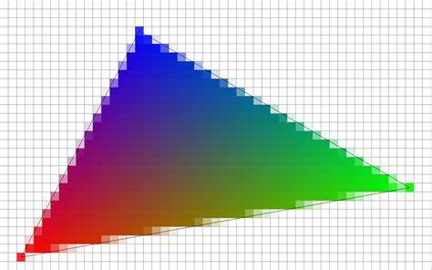
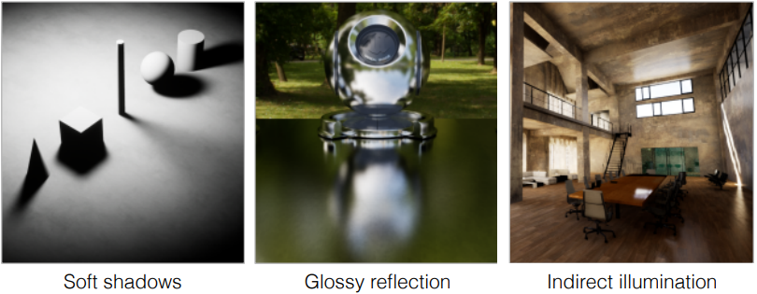
Approaches
§Rasterization (Real-time)
Use MVP transformation and antialiasing to project objects onto the screen, with approximate shading.
Fast but inaccurate; cannot handle global effects such as soft shadows, glossy reflection and inderect illumination.
Department of Statistics and Data Science

Slide 4
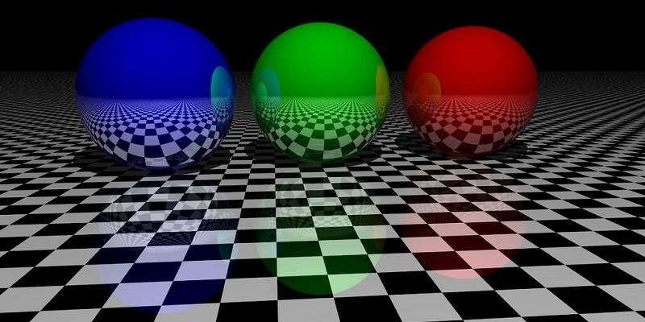
Approaches
§Ray Tracing (Usually Offline)
Simulate the process of how light rays propagate and hit onto the screen.
Accurate, but very slow.
Department of Statistics and Data Science

Slide 5
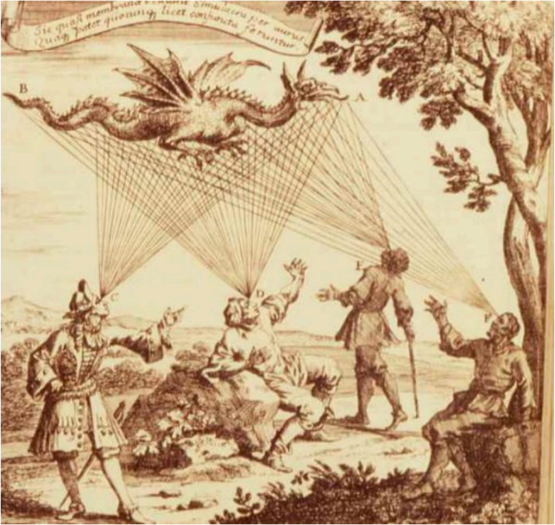
Basic Assumptions (for Simplicity)
§Light travels in straight lines (WRONG)
§Light rays do not collide with each other (Still WRONG)
§Light rays travel from the light sources to the eye(screen) - Optical Reciprocity
「Und wenn du lange in einen Abgrund blickst, blickt der Abgrund auch in dich hinein.」
——Friedrich Nietzsche
Eyes send out 「Feeling Rays」 into the world.
·Supported by
- Empedoceles
- Plato
- Euclid
- Ptolemy
- ...
- and 50% of US college students
Link
Department of Statistics and Data Science

Slide 6
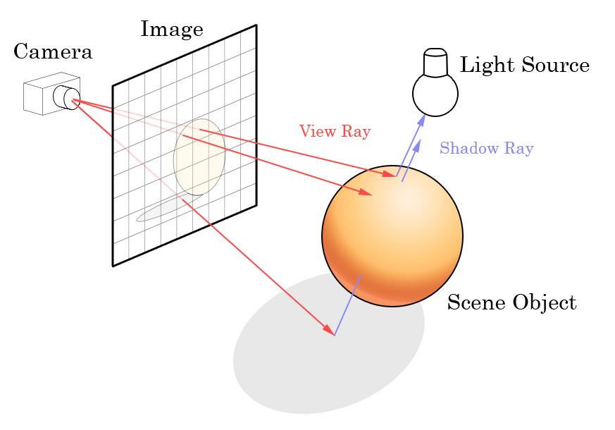
Ray Casting
§Generate an image by casting one ray from camera per pixel
§Check for shadows by sending a ray to the light source
Department of Statistics and Data Science

Slide 7
Ray-Surface Intersection
§Ray Equation
r(t) = o + td, 0 ≤ t < +∞
§General Implicit Surface
{p | f (p) = 0}
↓
§General Solution
f (o + td) = 0
r: ray
o: origin (eye)
t: 「time」
d: direction
p: point on surface
f: implicit surface equation
Department of Statistics and Data Science

Slide 8
Ray-Sphere Intersection
§Ray Equation
r(t) = o + td, 0 ≤ t < +∞
§Sphere Surface
{p : ||p - c||₂² = R²}
↓
§Solution
||o + td - c||₂² = R²
t = ...
r: ray
o: origin (eye)
t: 「time」
d: direction
p: point on the surface
c: spherical center
R: radius
Department of Statistics and Data Science

Slide 9
Ray-Plane Intersection
§Ray Equation
r( t ) = o + td, 0 ≤ t < +∞
§Plane Equation
{p : (p - p’)·n = 0} or {(x, y, z) : ax + by + cz + d = 0}
§Solution
t = (p’ - o)·n / d·n, check whether 0 ≤ t < +∞
n: Normal of the plane
p’: A specific point on the plane
Department of Statistics and Data Science

Slide 10
Ray-Triangle Intersection
§Check if ray intersects the plane first, then use triple cross products to check whether the intersection point is in the triangle.
Department of Statistics and Data Science

Slide 11
Ray-Triangle Intersection
§Möller Trumbore Algorithm: a faster approach using barycentric coordinate
Solve: o + td = b₁p₁ + b₂p₂ + (1 - b₁ - b₂)p₀
Let
E₁ = p₁ - p₀, E₂ = p₂ - p₀
S = o - p₀, S₁ = d × E₂, S₂ = S × E₁
Then
Check the conditions 0 < t < +∞ and b₁, b₂, 1 - b₁ - b₂ ∈[0, 1]
Department of Statistics and Data Science

Slide 12
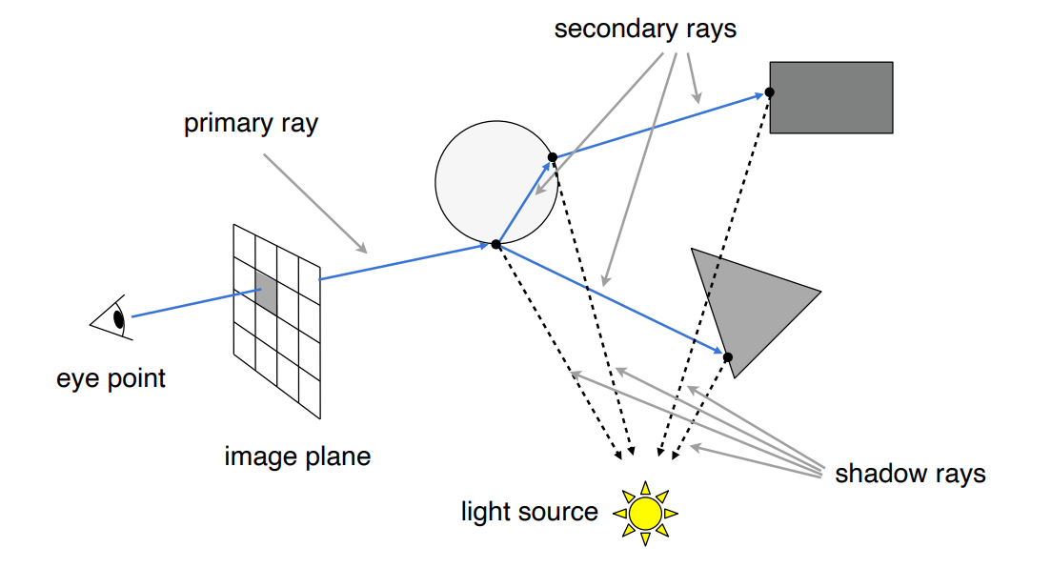
Recursive Ray Tracing (Whitted-Style)
§Calculate the colour recursively at every intersection point
Reflection + Refraction
Department of Statistics and Data Science

Slide 13
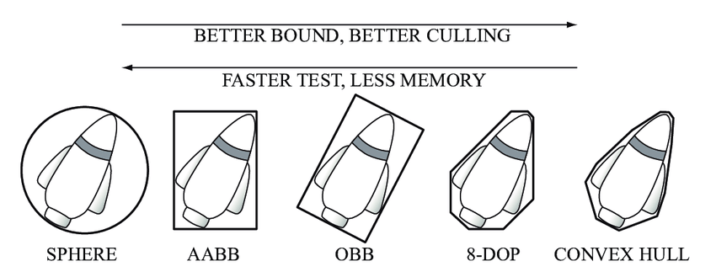
Accelerating Ray-Surface Intersection
§Bounding Volume
To use a simple geometric shape named bounding volume to bound complex objects. If a light ray does not intersect the bounding volume, obviously it cannot intersect the objects inside.
Department of Statistics and Data Science

Slide 14
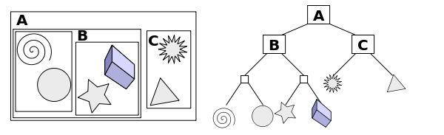
Accelerating Ray-Surface Intersection
§Bounding Volume Hierarchy
Find bounding box
Recursively split set of objects in 2 subsets
Recompute the bounding box of subsets
Stop when necessary
Store objects on leaf node
Department of Statistics and Data Science

Slide 15
More to Learn
BRDF (in-angle, out-angle) → ratio: a function that describes the reflection
BTDF (in-angle, out-angle) → ratio: a function that describes the refraction
Monte Carlo Path Tracing: to estimate the surface integral by sampling
...
Department of Statistics and Data Science

Slide 16
References
GAMES101
Department of Statistics and Data Science

Slide 17
Thanks for Watching

